Slide 1
Goats & Sheep: What You Need to Know
Kipp Brown
Extension Livestock Coordinator
Department of Animal and Dairy Sciences
Mississippi State University

Slide 2
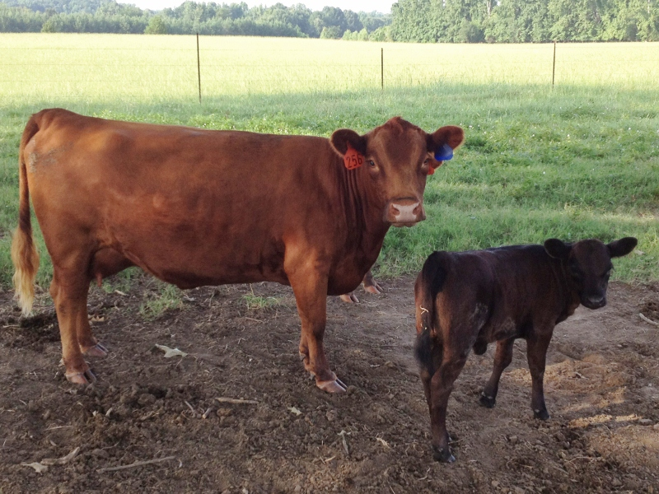
What is a small ruminant???
Little Cows?
OR
Sheep and goats?

Slide 3
FIRST LESSON!
Ruminants include cattle, sheep, goats, buffalo, deer, elk, and camels. These animals have a digestive system that is uniquely different from our own. Instead of one compartment to the stomach they have four. Of the four compartments the rumen is the largest section and the main digestive center. The rumen is filled with billions of tiny microorganisms that are able to break down grass and other coarse vegetation. Partially chewed fiber goes into the large rumen where it is stored and broken down into balls of “cud”. Once full, the animal will rest and “chew his cud". The cud is then swallowed once again where it will pass into the next three compartments—the reticulum, the omasum and the true stomach, the abomasum.

Slide 4
So, SHEEP AND GOATS ARE SMALL RUMINANTS!
REMEMBER-There is as much difference within breeds/species as between breeds/species.
HOWEVER, MOST IMFORMATION ON SHEEP AND GOATS IS RELATIVE TO BOTH SPECIES.

Slide 5
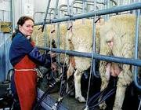
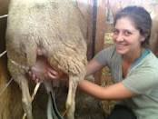
Sheep BREEDS can be
wool or hair, dairy, etc.
Goat BREEDS can be
meat or fiber, dairy, etc.

Slide 6
MAJOR DIFFERENCE:
SHEEP AND GOATS
Sheep graze.
Goats browse.
Goats require copper in the diet.
Sheep tolerate little copper in the diet.
(As a rule of thumb SHEEP NEED NO MORE THAN 4-8 PPM IN THE DIET)

Slide 7
SHEEP, GOATS, AND COPPER
HAIR Sheep ARE MORE TOLERANT OF COPPER THAN WOOL SHEEP
Do not feed swine or poultry feed to sheep. They contain high levels of copper by design.
Carefully investigate copper levels in beef or dairy products before feeding to sheep. Some of them will have high levels of copper, while others will not.
Communicate with feed company representatives or country elevators supplying feed. It is important that mixers are clean, augers clean, and feed delivery trucks clean before handling sheep feeds, especially if they mix and handle swine feeds.
Test feeds and forages for levels of copper, molybdenum and sulfur.
Avoid grazing sheep on pastures where swine or poultry waste is applied.
Consider adding molybdenum to the diet at a rate of 3 ppm.

Slide 8
SHEEP, GOATS, AND COPPER
GOATS REQUIRE some COPPER IN THEIR DIET
Always use a sheep mineral for sheep and a goat mineral for goats
If sheep and goats are running together, use sheep mineral to be safe
Sheep and goats do require minerals
Keep a good quality mineral out full time for optimum reproductive and nutritional health in sheep and goats

Slide 9
SHEEP AND GOATS ARE PRETTY MUCH THE SAME ANIMAL WITH BOTH BEING SMALL RUMINANTS, AND THEREFORE CAN BE MANAGED IN PRETTY MUCH THE SAME FASHION. THERE ARE SMALL DIFFERENCES IN COPPER LEVELS, AS WELL AS GRAZING AND BROWZING PREFERENCES.

Slide 10
HAIR SHEEP 101
What is a Hair Sheep?
Any breed or cross breed of sheep that is devoid of wool. Primarily used in the production of meat!

Slide 11
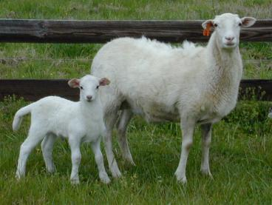
HAIR SHEEP..
Most breeds originated or trace
origins back to Africa
Dry desert types-South Africa
Tropical types-Caribbean/West Africa
Increasing numbers in the U.S. and MS
Decrease in wool value and increase in meat value
Production efficiency and ease of care

Slide 12
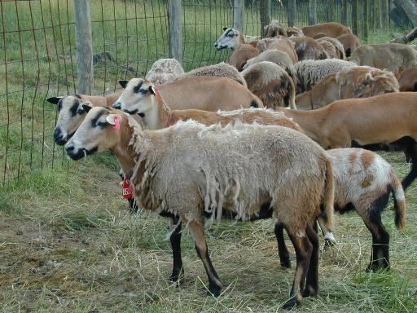
Breeds..
Droper (black and white)-ideal terminal sires
Katahdin-ideal maternal females
Barbados Black Belly
St. Croix
Damara
Crosses with hair and wool breeds

Slide 13
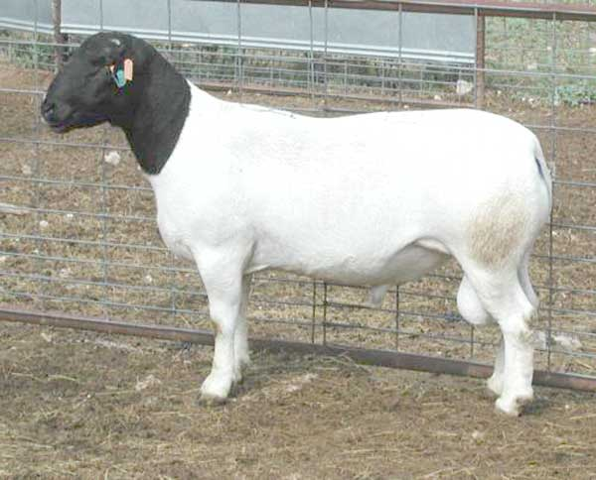
Hair compared to Wool…
Popularity is due to:
No shearing
Little/no docking of tails
High level of reproduction
Parasite resistance
Heat and humidity tolerance
Ideal for small lifestyle farms

Slide 14
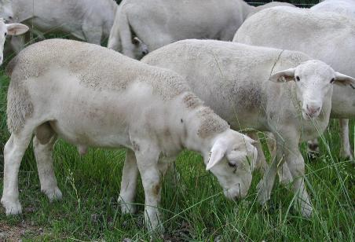
Major Differences to Wool Sheep
Fatten different from wool lambs
More like goats: from inside-out
More resistant to parasites
Less expense and ideally suited
to pasture based production
Studies show they produce a lean
meat with little or no mutton taste

Slide 15
SHEEP AND GOAT NUTRITION, HEALTH, REPRODUCTION, ETC.
Lessons learned in meat goat production will apply to hair sheep as well
There is evidence that hair sheep MIGHT Be more hardy and resistant to common problems associated with goats
The market FOR HAIR SHEEP will continue to expand in the future

Slide 16
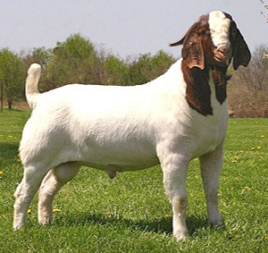
SO…..MOST MANAGEMENT
PRACTICES ARE THE SAME FOR BOTH HAIR SHEEP AND MEAT GOATS

Slide 17
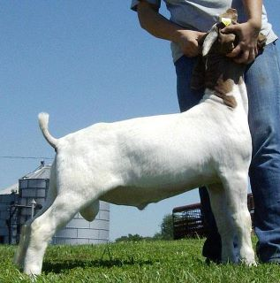
LET’S LOOK AT MEAT GOAT (HAIR SHEEP)
MANAGEMENT, NUTRITION, & REPRODUCTION….WITH OUR PRIMARY CONCENTRATION ON MEAT GOATS

Slide 18
MEAT GOAT (hair Sheep) 101
What is a MEAT GOAT?
Any breed or cross breed of goat that is primarily used in the production of meat!
Just like Hair Sheep!

Slide 19
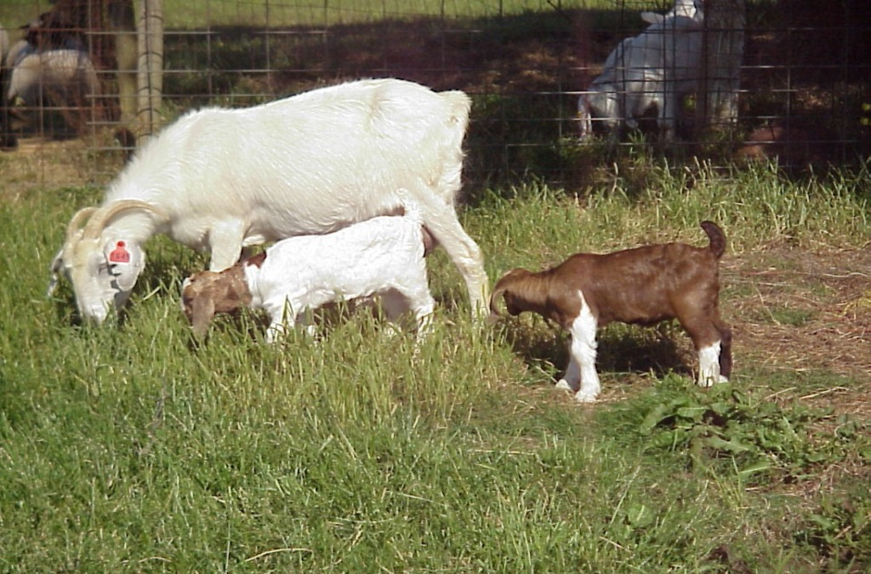
Types of Meat Goats
Boer cross is the most popular and well known in the U.S.
Kiko cross goats are gaining in popularity
Spanish type goats are making a comeback

Slide 20
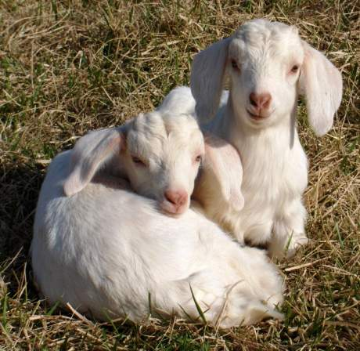
Goat management covers the raising and caring for goats including:
Feeding
Health Management
Breeding
Processing kids
Facilities

Slide 21
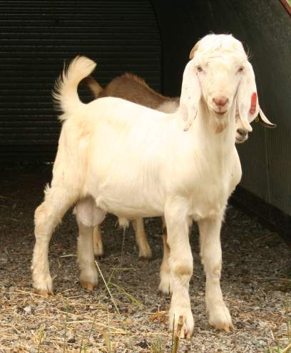
How many goats can I raise?
Depends on management and resources.
    Quantity, Quality, Type of Labor
    Quantity, Distribution, Management
  of Capital and Land
    Own or Borrowed Money!

Slide 22
There is really no “best” way to raise goats (SHEEP). Except!
The most economical way possible!
Do you work for the goats?
Do the goats work for you?

Slide 23
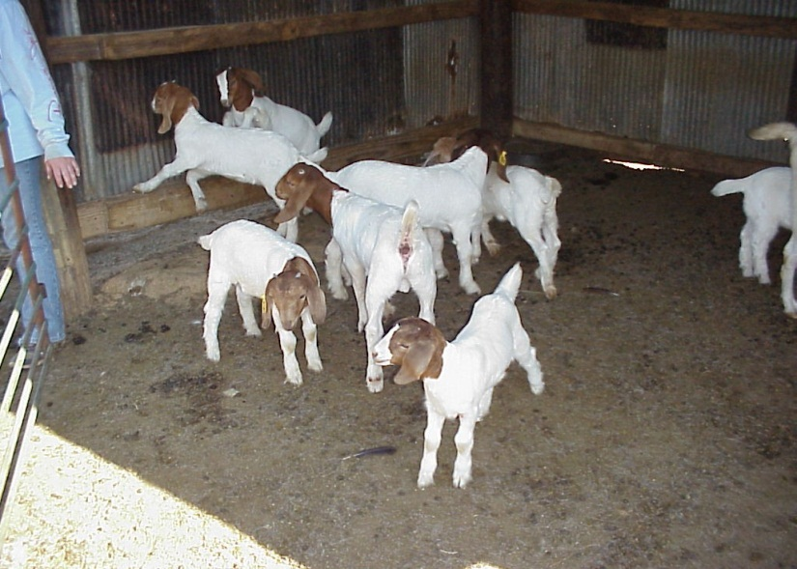
What factors are most important to insure a successful goat enterprise?
Nutrition
Reproduction
Health
Facilities
Marketing

Slide 24
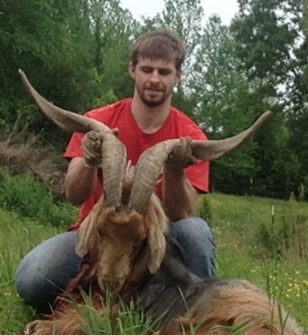
Nutrition..
Is the Highest
Cost Associated
with Production!

Slide 25
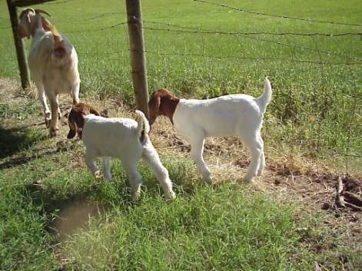
NUTRITION..
What do I feed my goats?
Ideally, roughage (pasture grasses, browse, and/or hay) should comprise a majority of the diet
Goats are selective grazers and prefer browsing to grazing when given a choice
Forage diets tend to cause fewer digestive problems
Browse diets cause fewer parasite problems

Slide 26
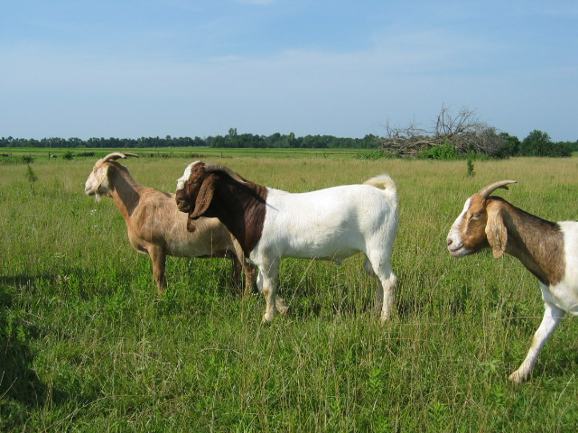
Doe Nutrition..
Define the stage of production and feed accordingly
  Dry
  Breeding
  Early Gestation
  Late gestation
  Lactation

Slide 27
Dry Period..
Period between weaning and breeding
Lowest nutrient requirements
  Good quality pasture should meet most requirement needs
  Regain weight lost during lactation
    Need 2% of body weight
    Need minerals free choice - salt, Ca, P
  No pasture? Grass Hay and .5-1.5# 16% CP pelleted (preferred) ration

Slide 28
Breeding Period..
Increase feed intake 2 - 3 weeks prior to breeding – Known as “Flushing”
  Increase ovulation rate 5 - 10%
Flushing
  1#/Hd/Day of Corn
  Monitor body condition score to avoid under or over conditioned goats
    Too fat or too thin
    Best at BCS 2 - Greater response

Slide 29
Early Gestation..
First 100 days (Gestation is 150 Days!)
Similar to dry feeding
Very little fetal growth
Take advantage of forage
Monitor body condition score

Slide 30
Late Gestation..
Last 50 days (gestation time 150 days)
Most critical time – 70% of fetal growth
  Poor nutrition costs production
    Low birth weights, mothering ability, low milk production, ketosis
Utilize pasture and supplement feeding
  Need 4 - 4.5% of body weight
  2# - 4# good quality hay + 2# corn

Slide 31
Lactation..
Doe nutrition is the key to early kid growth
Lactation peaks at 2 - 4 weeks
Utilize pasture
Feed at 4 - 5% body weight
  3# - 4# good hay + 3# - 4# grain

Slide 32
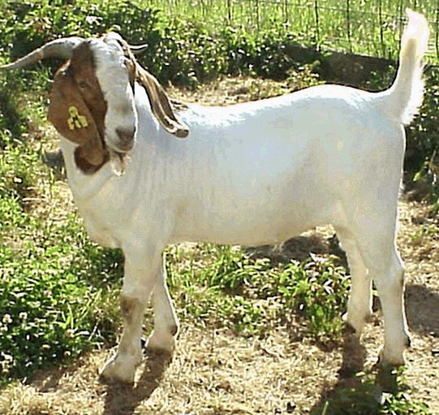
Buck Nutrition..
Utilize pasture when available
Monitor body condition 3-4 weeks prior to breeding
  4# of hay + 2# of grain
Monitor body condition
during breeding

Slide 33
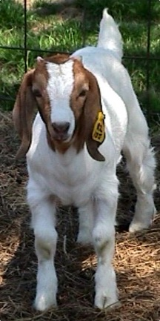
Reproduction: Equals
Economic Success!
Estrous cycle is 18 - 21 days
Short day breeders (Oct. - Dec.)
Flushing
  ½ - 1# per head per day of corn
  Deworm prior
  Turn on to new pasture
Monitor BCS (1 - 5)
  BCS of 2 for best results

Slide 34
Reproduction..
Accelerated Kidding
  3 crops in 2 years
  High input
BSE on Bucks
  Semen, libido, testicles, health
  Trim feet
  Good body condition

Slide 35
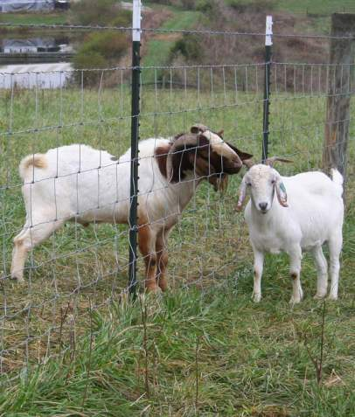
Reproduction..
The Buck effect
  Synchronizing
Controlled breeding season
  Efficient management of facilities

Slide 36
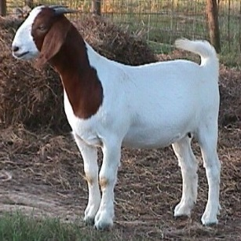
WHEN TO BREED.…
Annual kidding
Age at puberty averages 6 to 10 months (affected by breed, season, and nutrition)
Can breed doelings when they reach 2/3 of their mature weight
Goats are seasonal in their breeding habits
  Seasonality is affected by breed and individual
  Pros and cons to different kidding seasons: winter, spring, and fall

Slide 37
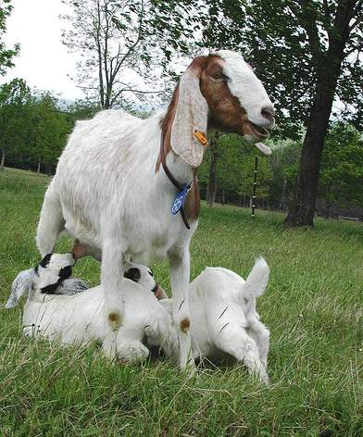
How many babies do goats usually have?
Normal range from 1 to 5
  Twins are the most common
  Triplets frequent (less in sheep)
  Yearlings often have a single
  4-5 kids is a rare occurrence
Reproductive rate is affected by breed, age, season, and nutrition
Genetics of reproduction
  Number of offspring determined primarily by doe (number of eggs ovulated sets upper potential)
  Sex of offspring determined primarily by buck

Slide 38
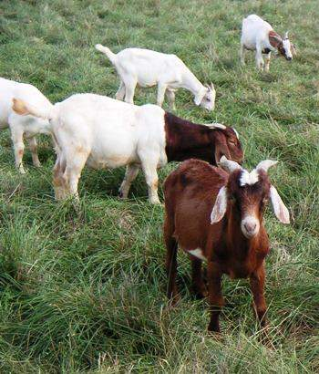
Should I castrate my buck kids?
Yes, if . . .
You don’t sell or separate buck kids from their dams and female siblings by the time they are three months old
Your market discounts intact males
You want better growth rates in late summer and fall
IF NOT, DON’T WORRY ABOUT IT!
There should be an economic benefit to expend the time, expense and effort

Slide 39
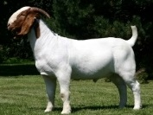
MEAT GOAT
HEALTH & DISEASE, PARASITES, AND FACILITIES

Slide 40
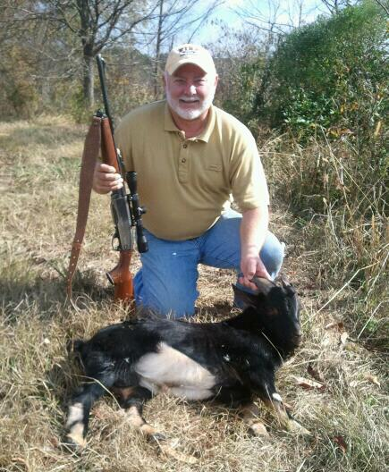
Health..
Diseases and Problems
  Ketosis
  Overeating
  Parasites (worms)
  Coccidia
  Foot rot or scald
  Pinkeye
  General sickness

Slide 41
Health..
Most Important the Last Trimester
Ketosis
  Feeding management
Overeating/Tetanus-Vaccinate (CD/T) 2-4 weeks prior to kidding
  Gives immunity to the kids
Vitamin E and Selenium (if needed)
Deworm – offset post kidding rise in parasites (check dewormer for abortion possibility)

Slide 42
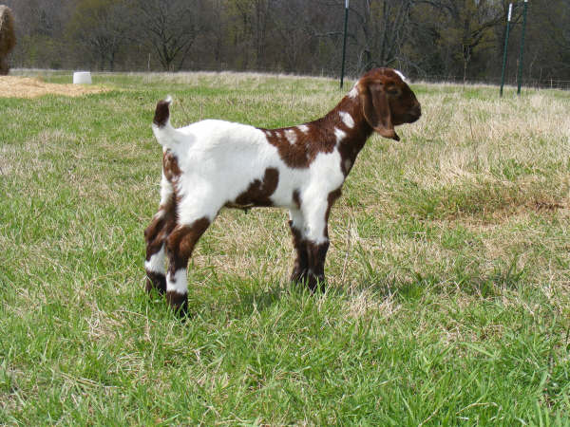
Health
Kidding Time
Kid in clean areas
Dip – Snip – Strip
  Iodine navel
  Trim navel
  Inspect udder
May give 1ml BoSe if needed
See that kid gets colostrum

Slide 43
Health..
Kids 1 to 4 weeks of age
Disbud (7 - 10 days) if of economic value
Castrate (after 8 weeks to help prevent urinary calculi) if of economic value
Vaccinate with CD/T (14 – 28 days) ALWAYS!
Watch for scours
  E-coli
  Coccidia

Slide 44
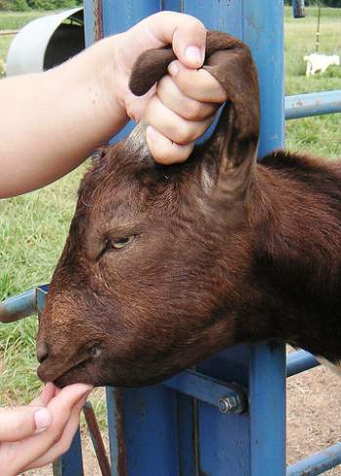
MOST COMMON HEALTH PROBLEM FOR GOATS IN THE SOUTHERN U.S.
Internal Parasites
  Barber Pole Worm (Most Common)
  Coccidia
  Tapeworm
  Lung Worm
  Liver Fluke
  Meningeal Worm

Slide 45
Health..
Deworming for the Barber Pole Worm
Establish a program
Check fecal samples
Use FAMACHA
  Deworm only when needed
  Rotate wormers yearly or when there is no response
    Rotate between “Families” or classes of products
  Give orally over the tongue

Slide 46
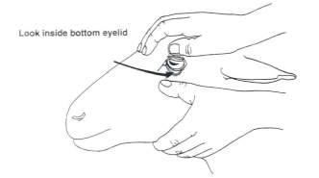
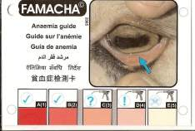
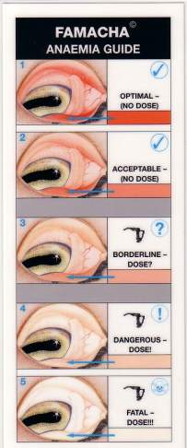
The FAMACHA© System for assessing anemia and barber pole worm infection in small ruminants
Clinical Category | Color | PCV (hematocrit) | Deworming recommendation
1 | Red | > 28 | No
2 | Red-Pink | 23-27 | No
3 | Pink | 18-22 | ?
4 | Pink-White | 13-17 | Yes
5 | White | < 12 | Yes
The FAMACHA© system should be used as part of an integrated parasite management program that employs other best management practices.

Slide 47
Health..
Use Strategic Deworming
Hold feed - leave in pen (12-48 hours)
Rotate to clean pastures
Do not under dose
  Metabolism is 2.5-3.0 times that of larger species
  Rule of thumb – Use at 2.5 X cattle rate
  Calculate rate based on the heaviest doe
Always select animals with resistance to parasites for replacements

Slide 48
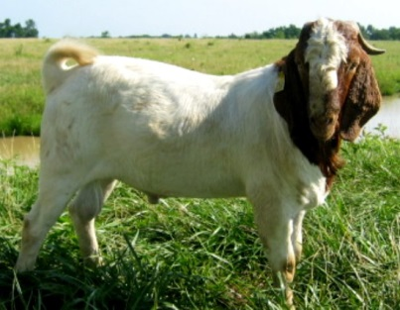
CONTROLLING INTERNAL PARASITES
Pasture rest/rotation
Multi-species grazing
Browsing instead of grazing
Manage grazing height (above 4”)
Use alternative forages
Genetic selection for resistance within/between breeds

Slide 49
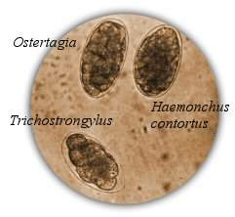
CONTROLLING INTERNAL PARASITES
Use selective deworming
Not everyone, not every month
Use proper drug rate
2-3 TIMES CATTLE DOSE!
Use fecal testing to determine effectiveness
DRUG RESISTANCE IS A MAJOR ISSUE!

Slide 50
CONTROLLING INTERNAL PARASITES
  Tapeworm-
  Lung Worm-
  Liver Fluke-
  Meningeal Worm-
  All are minor problems with good herd health management!

Slide 51
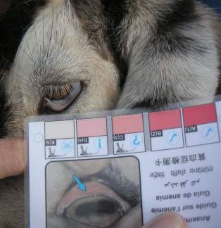
THE TAKE HOME MESSAGE!!!
Deworming
Establish a program
Check fecal samples
Use FAMACHA
  Deworm only when needed
  Rotate wormers ONLY when there is no response, then change class of product
  Give orally OVER the tongue
  Use the proper rate to avoid resistance!

Slide 52
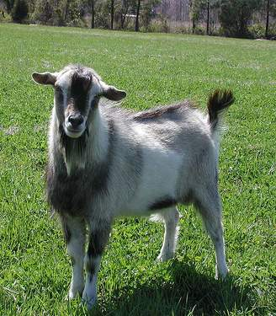
HEALTH..
Digestive problems
There can be many different causes of diarrhea (scours) in goats
  Infectious
  bacterial, viral, protozoa
  Non-infectious
  nutrition, management, stress
Most digestive problems (bloat, acidosis) are caused by diet changes, usually sudden
Know what you’re dealing with and treat symptoms accordingly

Slide 53
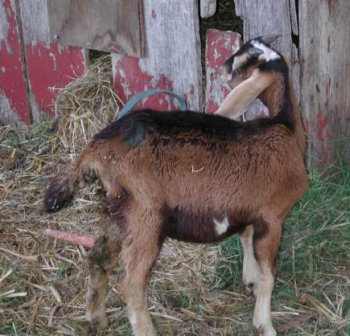
What about Coccidia?
**Is a serious problems in kid goats**
A single-cell protozoa that can damage the lining of small intestines and cause diarrhea
Is species and site-specific
Use Prevention Options
  Good sanitation
  Proper stocking/penning rates
  Use coccidiostats
    Such as Bovatec®, Rumensin®
    and Deccox® in mineral/feeds
    Corid in water
Treat with Corid or sulfa drugs
***Rumensin®, Bovatec®, and Deccox® are toxic to horses, donkeys, and mules.***

Slide 54
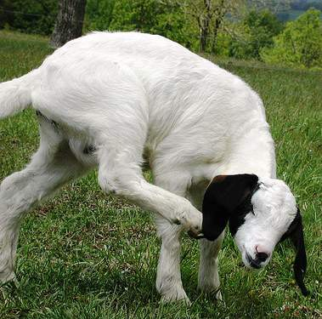
HOOF PROBLEMS
  Foot Rot
  Damage to the hoof
  Foot Scald
Irritation between the toes of the hoof
Foot scald can occur seasonally
Primarily in wet conditions
Both foot scald and rot are inherited traits
Cull animals that are regularly infected!

Slide 55
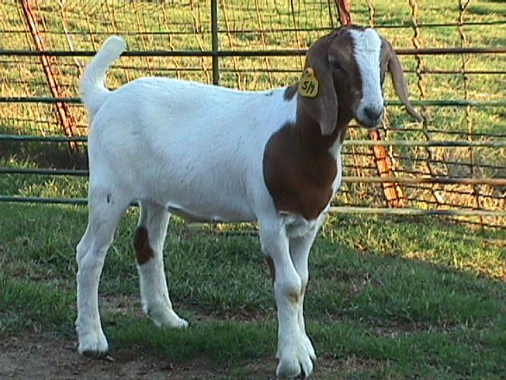
RESPIRATORY PROBLEMS
Pneumonia
Wet, dirty pens
Poor circulation
Dry, dusty pens
Stress

Slide 56
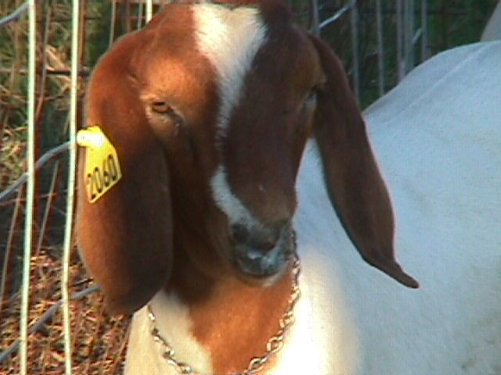
RESPIRATORY PROBLEMS
Pneumonia
Elevated temperature (104°F or better)
Runny nose
Rapid, rough sounding breathing
Off feed or poor appetite
  Normal body temperature is usually 102-103°F

Slide 57
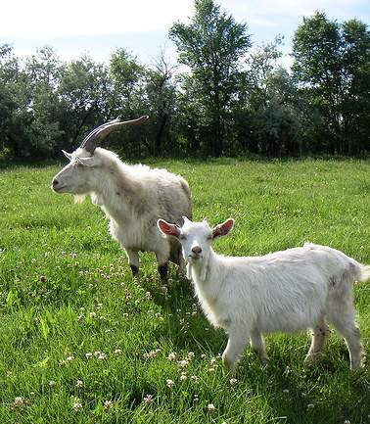
RESPIRATORY SYMPTOMS
Coughing, Nasal Discharge, Congestion, Wheezing, Sneezing, Fever-Not always infectious!
Infectious Pneumonia
  Usually a secondary infection caused by:
    Viruses-Bacteria-Parasites
Non-infectious
Usually caused by:
  Lungworms-Nasal bots-Poor ventilation-Dusty feed

Slide 58
QUICK HITS
URINARY CALCULI
CAUSES
Diet, water, genetics
Improper Ca:P ratio (2:1 recommended)
  Stones usually lodge in the bend of the urinary tract know as the sigmoid flexure, or at the tip of the tract called the filiform; either situation prevents urination

Slide 59
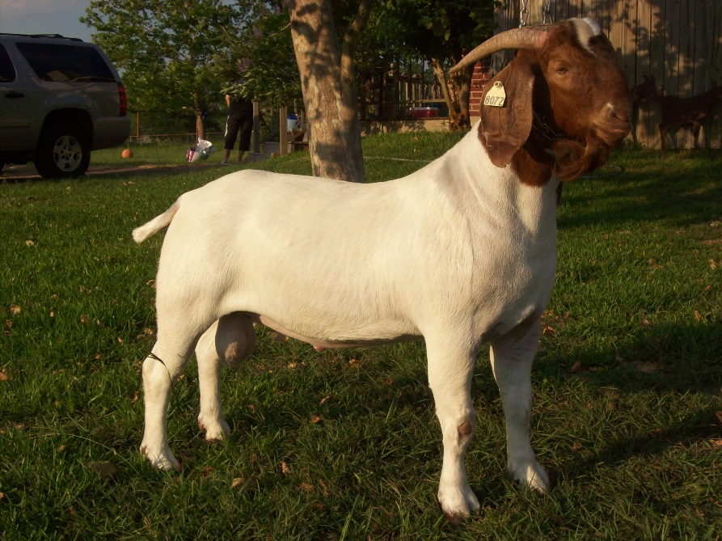
URINARY CALCULI
SYMPTOMS
Restlessness, getting up and down
Straining to urinate
Pawing the ground
Tail twitching
Looking at abdomen
Vocalizations of pain and discomfort
Final stages; grinding of teeth

Slide 60
URINARY CALCULI
TREATMENT
Treatment for Urinary Calculi should be done by experienced veterinarians
In most cases the tip of the urinary tract must be removed
Blockage must be removed with a catheter

Slide 61
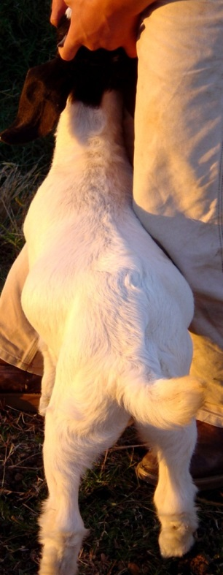
URINARY CALCULI
PREVENTION
Use a proper, balanced feed ration
Use a ration containing ammonium
chloride or ammonium sulfate
Provide free choice mineral
Provide clean, fresh water
Know your water (pH) source!

Slide 62
OVEREATING AND TETANUS
Prevention
Vaccinate for clostridium perfringens and tetanus (CD&T)
Give a booster 2 weeks later
Booster young goats every 1-2 months
If you didn’t see the goat vaccinated, do it yourself!

Slide 63
OVEREATING AND TETANUS
TREATMENT
Usually the first sign of overeating is death
For tetanus, can inject tetanus antitoxin if diagnosed early, but not likely to help
Both overeating and tetanus will kill small ruminants!
If you didn’t see the animal vaccinated, do it yourself!!!

Slide 64
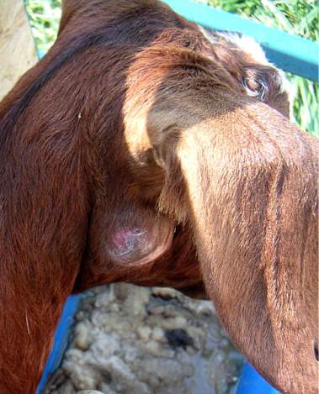
Other Diseases of Concern
Caseous Lymphadenitis (CL)
  Internal and lymph node abscesses
  Chronic, highly contagious
  Treatment
  Formalin injected at 12:00 into abscess
  Drain, clean, and destroy any liquid leakage by burning

Slide 65
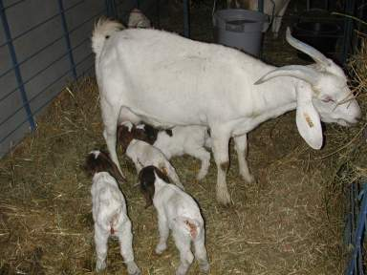
OTHER DISEASES OF CONCERN
Caprine Arthritic Encephalitis (CAE)
  Colostrum is primary mode of transmission

Slide 66
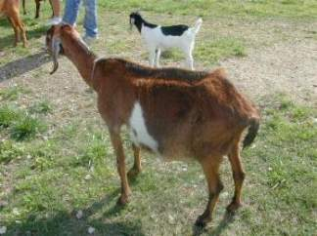
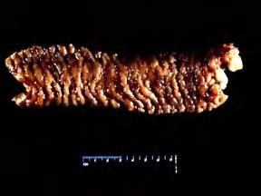
Other Diseases of Concern
Johne’s Disease
  May be more common than we think
  Is a digestive (wasting) type
Scrapie
  A federal regulatory issue that
  imposes USDA ID requirements
  Is a neurological, wasting type

Slide 67
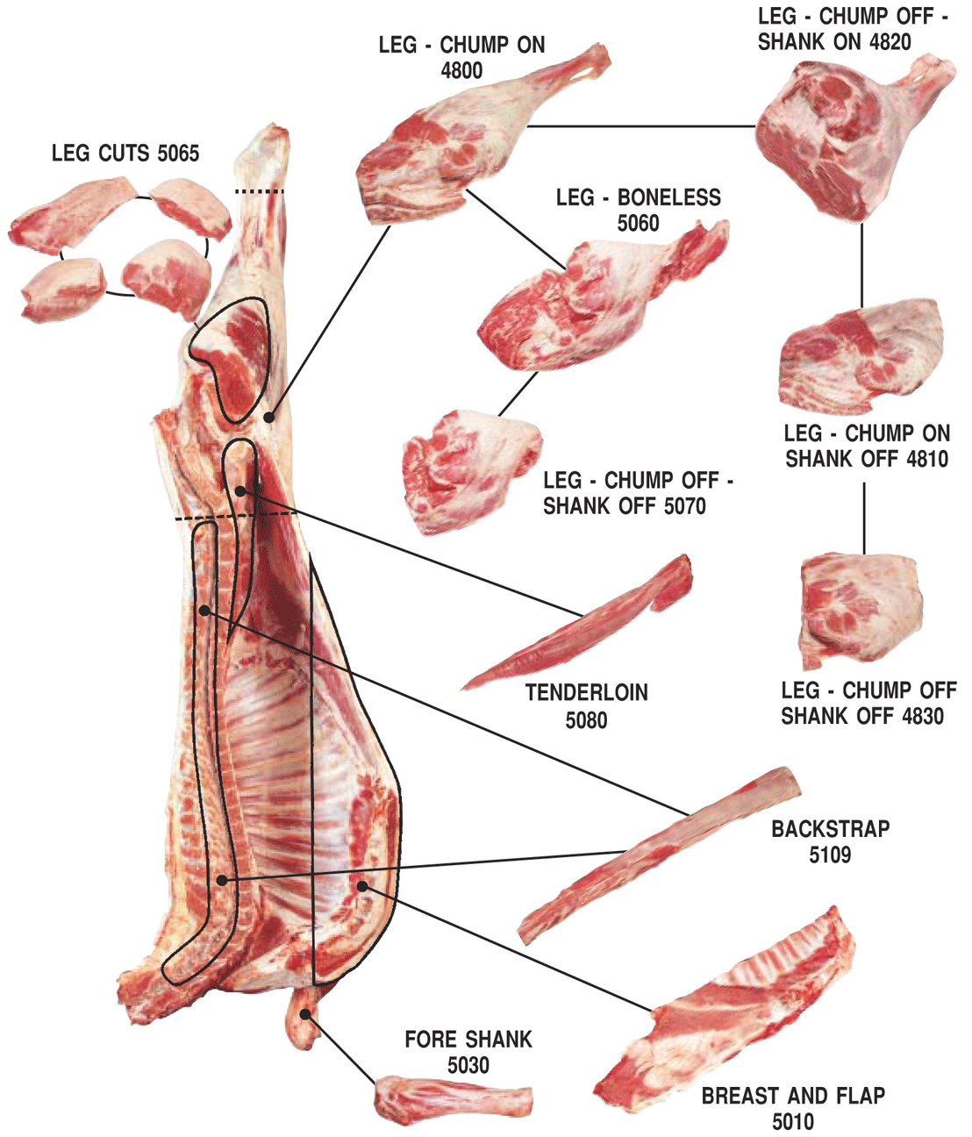
FEDERAL SCRAPIE PROGRAM
Mississippi is included in the federal eradication program
Premise I.D. is required for small ruminant operations
Scrapie tags are required to market small ruminants
  Tags and applicator are free from USDA
    Contact:
      Charles Garrity
      Animal Identification Coordinator
      USDA/APHIS
      601-807-8085

Slide 68
Facilities..
Corrals should be 5-6 feet tall
  Use net wire or 4 X 4 welded wire
Chutes
  12” wide, with smooth sides, slightly curved
    Well lighted
    Movement uphill

Slide 69
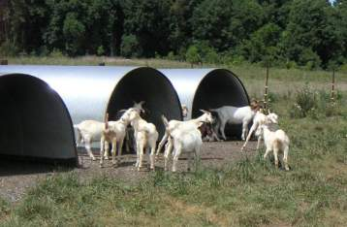
Facilities..
Sheds
  Allow 5 sq. ft. per animal
  Need two sides minimum
  Kidding area
  Can use jugs or hutches

Slide 70
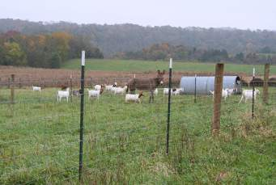
Fencing..
Net Wire
  12” vs 6” wire; at least 48” tall
  Barbed wire on top and bottom
Electric Fencing
  High maintenance
  Good for temporary or rotation systems
Combination of net and electric is best
If you can throw water through it, a goat can go through it!
Never discount good Fencing systems!

Slide 71
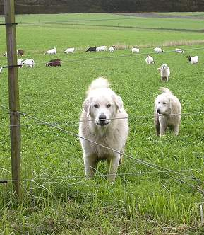
Predators..
Dogs, coyotes, feral hogs
Fencing is your best deterrent
Consider guard animals
  Dogs, llamas, donkeys
Use night penning
Kid in protected areas
Consider traps, snares, and hunting
  If you have coyotes, but don’t have losses, do not kill them
  New coyotes with a taste for goat may move into the area

Slide 72
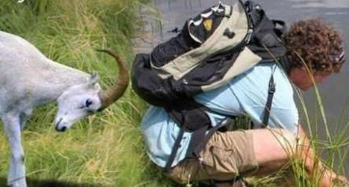
Always Cover Your Backside!
Know how to survive if things start going wrong…
Know your limits…

Slide 73
www.msucares.com
livestock/goats and sheep
For more information
Budgets-publications-videos-power points

Slide 74
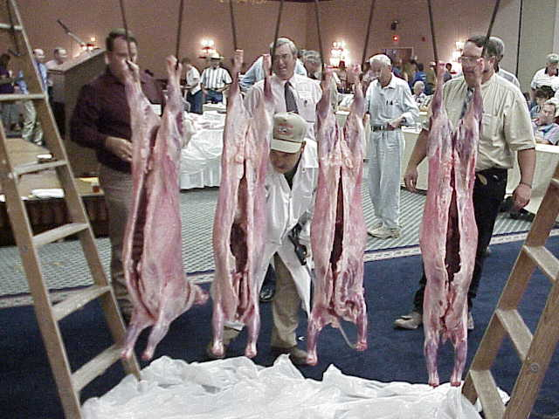
QUESTIONS?

