Slide 1
MEAT GOAT PROBLEMS
Kipp Brown
Extension Livestock Coordinator
Department of Animal and Dairy Sciences
Mississippi State University

Slide 2
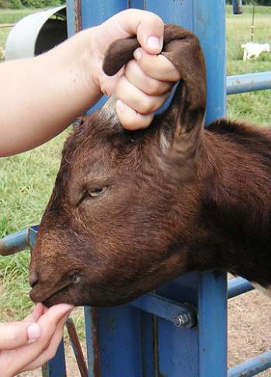
MOST COMMON HEALTH PROBLEMS FOR GOATS IN THE SOUTHERN U.S.
Internal Parasites
Barber Pole Worm
Coccidia
Tapeworm
Lung Worm
Liver Fluke
Meningeal Worm

Slide 3
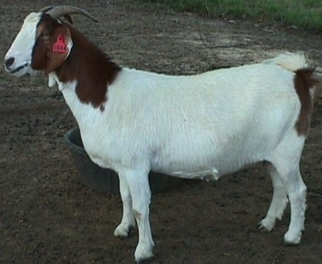
MOST COMMON HEALTH PROBLEMS FOR GOATS IN THE SOUTHERN U.S.
Hoof Problems
Foot Rot
Foot Scald
Respiratory Problems Pneumonia
Digestive Problems Scours
Acidosis
Bloat

Slide 4
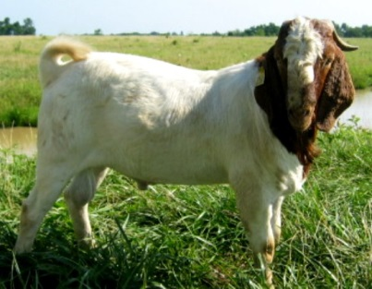
CONTROLLING INTERNAL PARASITES
Pasture rest/rotation
Multi-species grazing
Zero grazing
Browsing
Manage grazing height
Alternative forages
Genetic selection within/between breeds

Slide 5
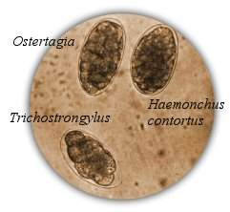
CONTROLLING INTERNAL PARASITES
Selective deworming Not everyone, not every month
Proper drug use
2-3 TIMES CATTLE DOSE!
Fecal testing to determine effectiveness of drugs
DRUG RESISTANCE IS A MAJOR ISSUE!

Slide 6
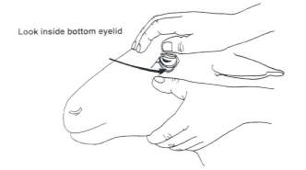
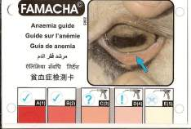
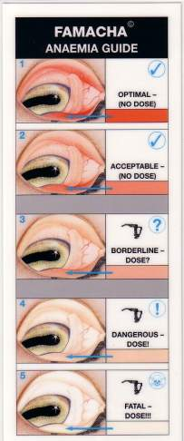
THE FAMACHA© SYSTEM For assessing anemia and barber pole worm infection in small ruminants
Clinical Category | Color | PCV (hematocrit) | Deworming recommendation
1 | Red | > 28 | No
2 | Red-Pink | 23-27 | No
3 | Pink | 18-22 | ?
4 | Pink-White | 13-17 | Yes
5 | White | < 12 | Yes
The FAMACHA© system should be used as part of an integrated parasite management program that employs other best management practices.

Slide 7
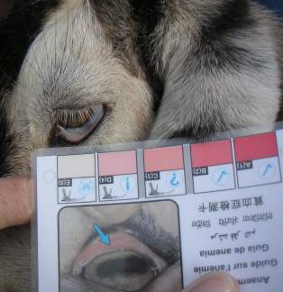
TAKE HOME MESSAGE
Deworming
Establish a program
Check fecal samples
Use FAMACHA
Deworm only when needed
Rotate wormers ONLY when there is no response, then change class of product
Give orally
Use proper rate to avoid resistance

Slide 8
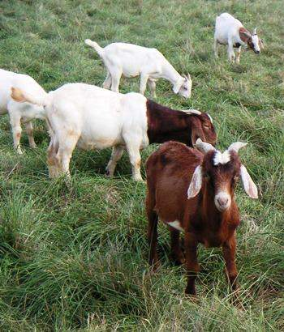
CONTROLLING INTERNAL PARASITES
Tapeworm-
Lung Worm-
Liver Fluke-
Meningeal Worm-
Minor problems with good herd health management

Slide 9
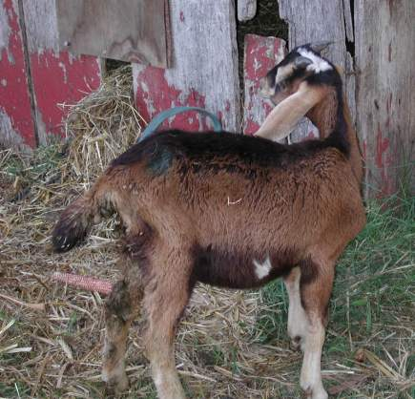
COCCIDIA **Can be a serious problem in kid goats**
Single-cell protozoa that damage lining of small intestines and cause diarrhea in kids.
Species and site-specific.
Prevention
Good sanitation
Proper stocking/penning rates
Use of coccidiostats in water, feed, or mineral.
Bovatec®, Rumensin® and Deccox®
Corid
Treat with Corid or sulfa drugs
***Rumensin®, Bovatec®, and Deccox® are toxic to horses, donkeys, and mules.***

Slide 10
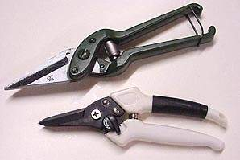
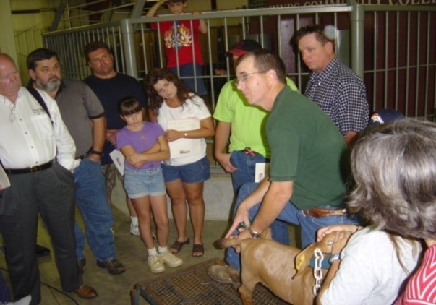
HOOF PROBLEMS
Frequency of hoof trimming varies among goats, people, and farms.
Restraint: lift hoof while goat is standing on table, platform, or ground. Harder to tip goats on rump. There are tilt tables available
Don’t buy goats with foot rot.
Foot scald can occur seasonally when it is wet.

Slide 11
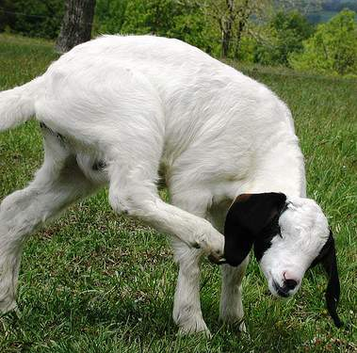
HOOF PROBLEMS
Foot Rot
Damage to the hoof
Foot Scald
Irritation between the toes of the hoof
Foot scald can occur seasonally. Wet conditions.
Both foot scald and rot are inherited traits. Cull animals that are regularly infected.

Slide 12
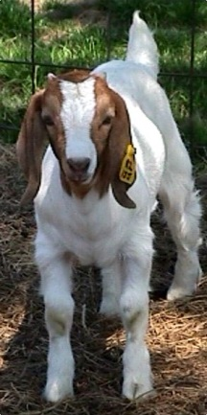
RESPIRATORY PROBLEMS
Pneumonia
Wet, dirty pens
Poor circulation
Dry, dusty pens
Stress

Slide 13
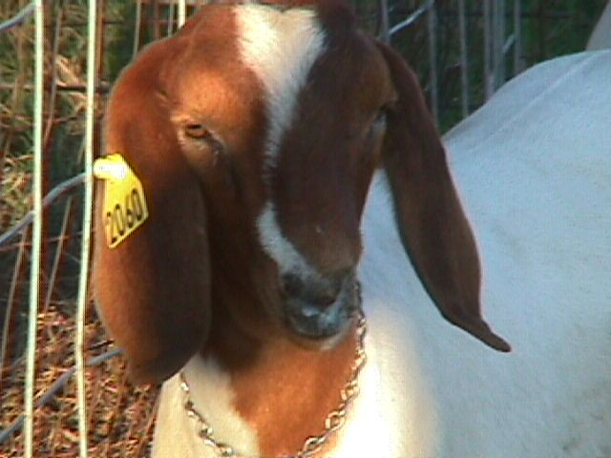
RESPIRATORY PROBLEMS
Pneumonia
Elevated temperature
Runny nose
Rapid, rough
sounding breathing
Off feed
or poor appetite

Slide 14
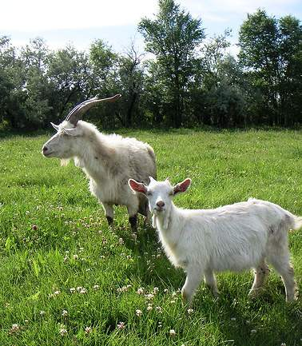
RESPIRATORY SYMPTOMS Coughing, Nasal Discharge, Congestion, Wheezing, Sneezing, Fever
Infectious
Pneumonia
Often occurs as a secondary infection associated with ketosis, milk fever, bloat, acidosis, etc.
Viruses
Bacteria
Parasites
Non-infectious
Lungworms
Nasal bots
Poor ventilation
Dusty feed
Stress
Normal body temperature is usually 102-103°F.

Slide 15
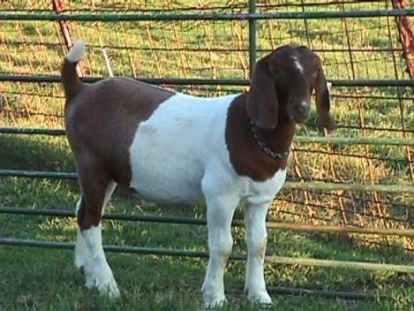
DIGESTIVE PROBLEMS
There are many different causes of diarrhea (scours) in goats.
Infectious Bacterial, Viral, Protozoa
Non-infectious Nutrition, Management, Stress
Most digestive problems (bloat, acidosis) are caused by diet changes, usually sudden.
Know what you’re dealing with and treat symptoms.

Slide 16
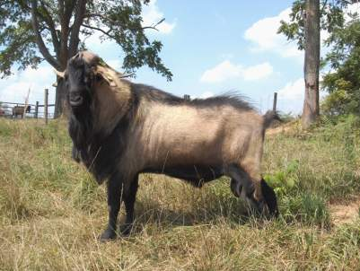
TREATING DIGESTIVE PROBLEMS
Scours/Diarrhea
Pepto-bismol bismuth subsalicylate
Kaopectate Kaolin-Pectin
Probiotics (yogurt)
Electrolytes (Gatorade®)
Nutri-drench (corn oil + karo syrup + molasses)
Bloat, Acidosis
Mylanta
Vegetable oil
Mineral oil
Baking soda

Slide 17
QUICK HITS
URINARY CALCULI
CAUSES
Diet, water, genetics
Improper Ca:P ratio (2:1 recommended)
Stones usually lodge in the bend of the urinary tract know as the sigmoid flexure, or at the tip of the tract called the filiform; either situation prevents urination

Slide 18
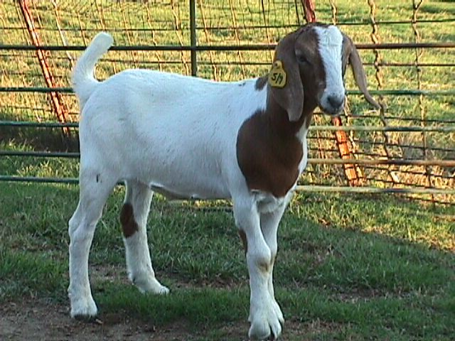
URINARY CALCULI
SYMPTOMS
Restlessness, getting up and down
Straining to urinate
Pawing the ground
Tail twitching
Looking at abdomen
Vocalizations of pain and discomfort
Final stages; grinding of teeth

Slide 19
URINARY CALCULI
TREATMENT
Treatment for Urinary Calculi should be done by experienced veterinarians
In most cases the tip of the urinary tract must be removed
Blockage must be removed with a catheter

Slide 20
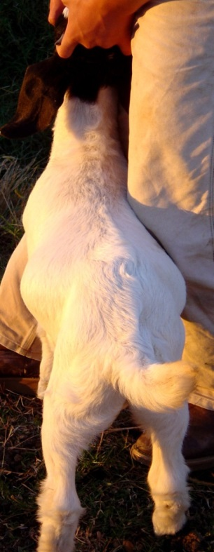
URINARY CALCULI
PREVENTION
Proper, balanced feed ration
Ration containing ammonium
chloride or ammonium sulfate
Free choice mineral
Provide clean, fresh water
Know your water source!

Slide 21
OVEREATING AND TETANUS
Prevention
Vaccinate for clostridium perfringens and tetanus (CD&T)
Give a booster 2 weeks later
Booster young goats every 1-2 months
If you didn’t see the goat vaccinated, do it yourself anyway!

Slide 22
OVEREATING AND TETANUS
TREATMENT?
Usually the first sign of overeating is death.
Possible to inject tetanus antitoxin if diagnosed early, but not likely to help.
If you didn’t see the goat vaccinated, do it yourself anyway!

Slide 23
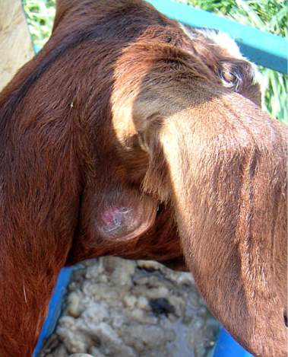
DISEASES OF CONCERN
Caseous Lymphadenitis (CL)
Internal and lymph node abscesses
Chronic, contagious

Slide 24
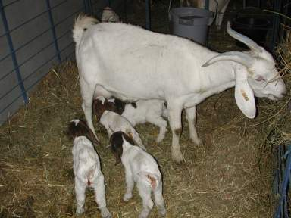
DISEASES OF CONCERN
Caprine Arthritic Encephalitis (CAE)
Arthritis, encephalitis
Colostrum is primary mode of transmission

Slide 25
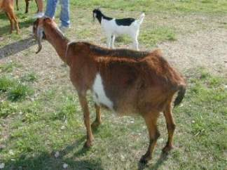
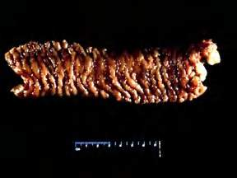
DISEASES OF CONCERN
Johne’s Disease
More common than we think?
Digestive (Wasting)
Scrapie
Regulatory issue USDA ID requirements
Neurological, Wasting

Slide 26
FOR FURTHER INFORMATION
www.msucares.com
livestock/goats and sheep

